Slide 1
Deep Learning
~ Pankaj

Slide 2
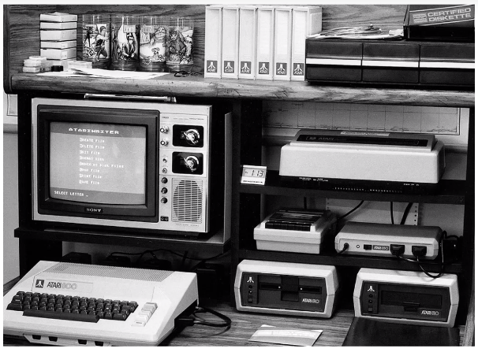
Deep Learning

Slide 3
Deep Learning
It was talk of town in 1980 ….
But it died in next decades
Then it got revived.

Slide 4
Deep Learning
It was talk of town in 1980 ….
But it died in next decades
Then it got revived.
WHY ?

Slide 5
Deep Learning
It was talk of town in 1980 ….
But it died in next decades
Then it got revived.
WHY ?
Due to Evolution of Technology

Slide 6
Deep Learning

Slide 7
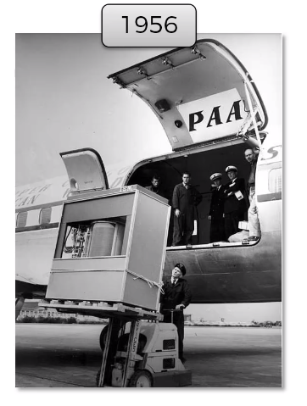
Deep Learning

Slide 8
Deep Learning
This is only 5 MB of hard – drive.
Company had to pay during that time $2500 / month just to rent it … yes not buy but to rent it.

Slide 9
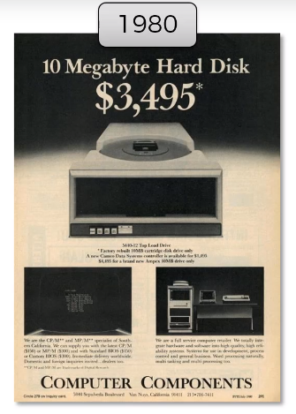
Deep Learning

Slide 10
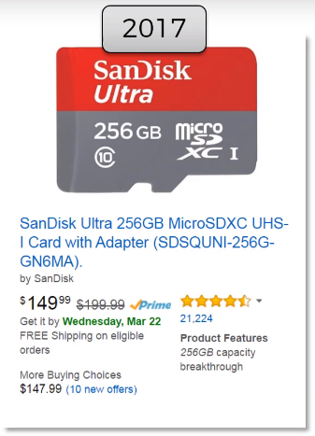
Deep Learning

Slide 11
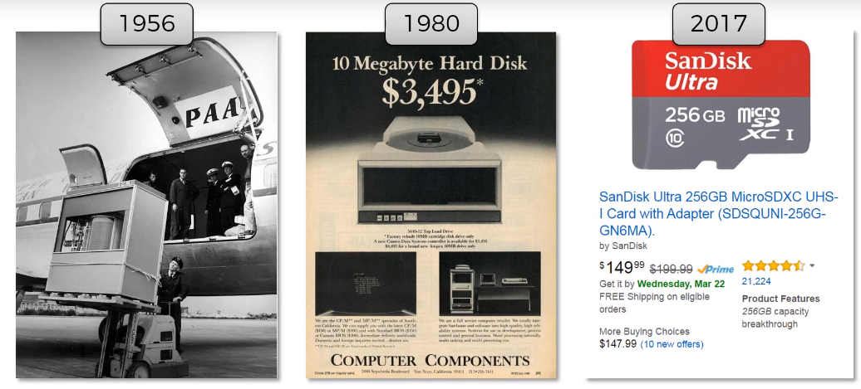
Deep Learning

Slide 12
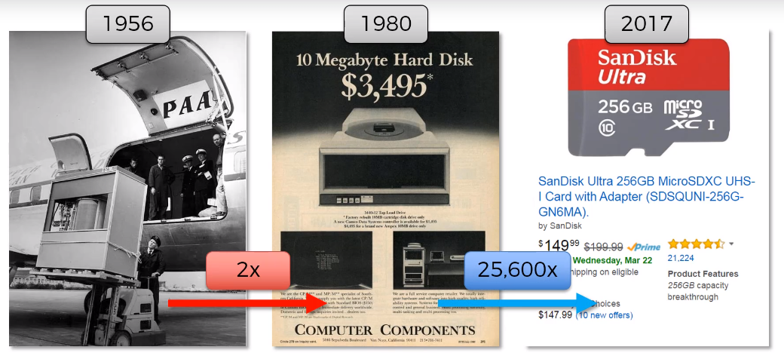
Deep Learning

Slide 13
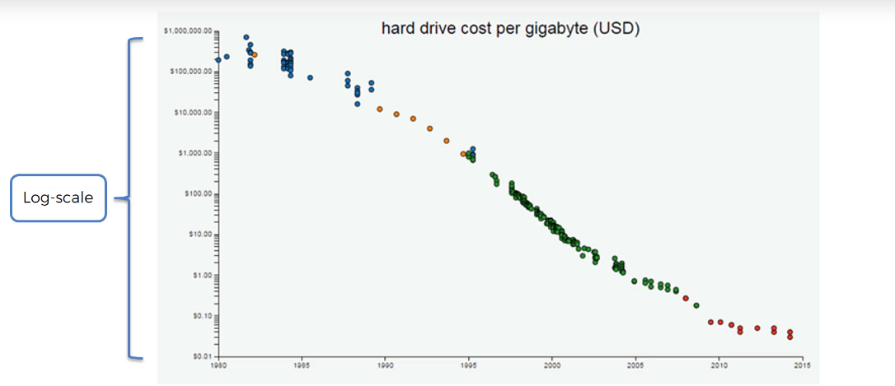
Deep Learning
Decrease in the price of storage and now even free storage are available – example ( Dropbox, cloud )

Slide 14
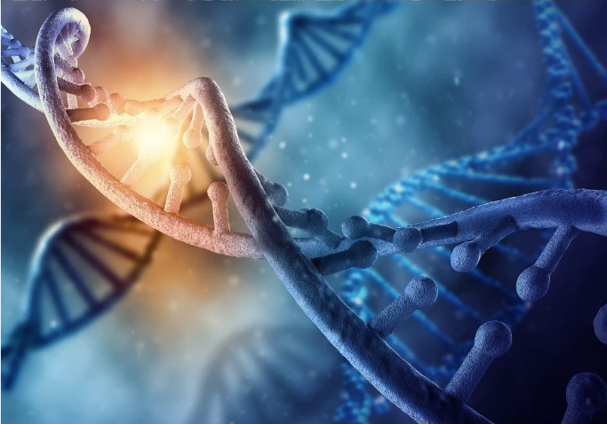
Deep Learning
Scientist are exploring using DNA for storage – it costs $7K synthesise 2MB of data and $2K to read the data

Slide 15
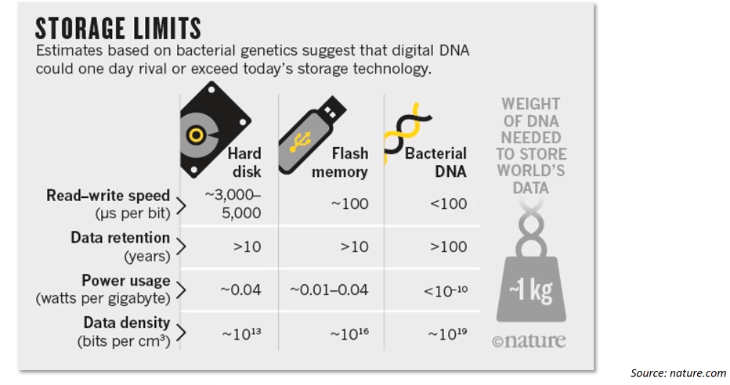
Deep Learning
This is why Deep Learning is picking up, as now we can store massive amount of data.

Slide 16
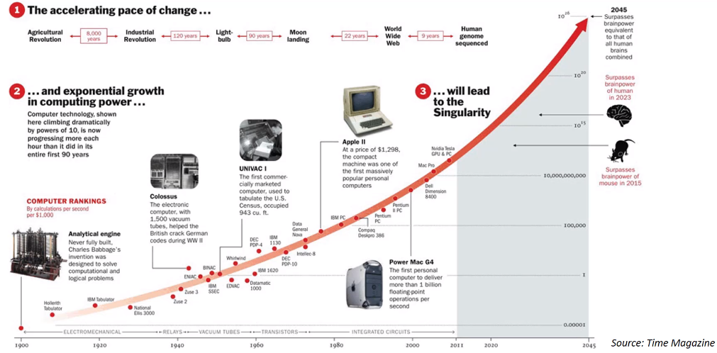
Deep Learning

Slide 17
Deep Learning

Slide 18
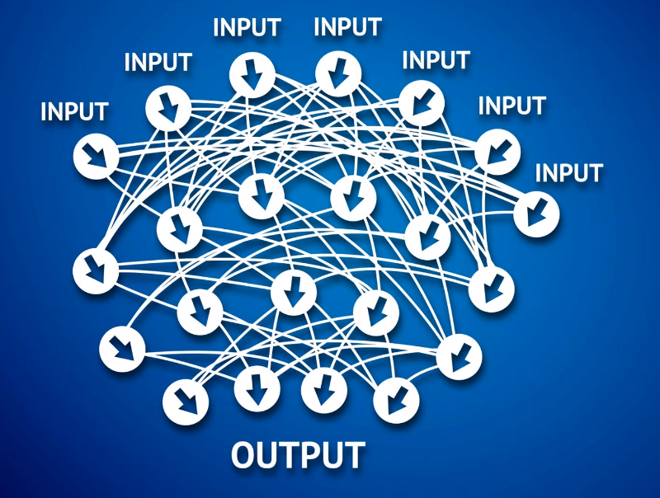
Deep Learning
This is Deep Learning …

Slide 19
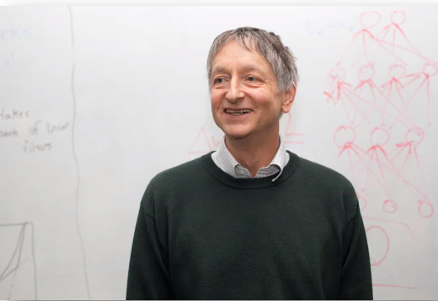
Deep Learning
Geoffrey Hinton – God Father of Deep Learning

Slide 20
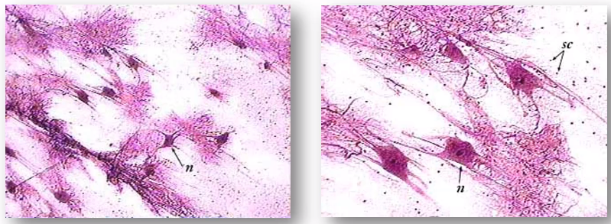
Deep Learning
Neuron

Slide 21
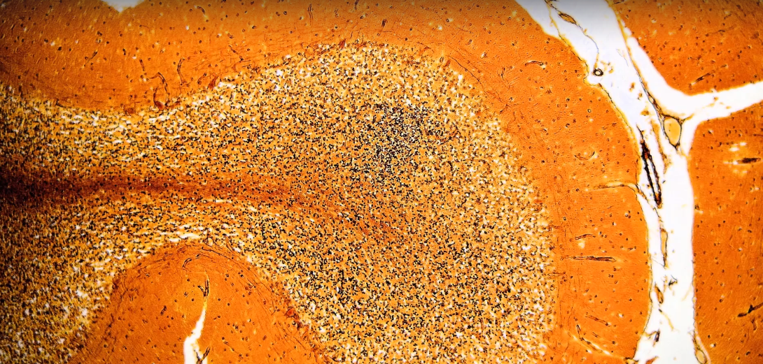
Deep Learning
Actual Image of Cerebrum containing billions of Neuron

Slide 22
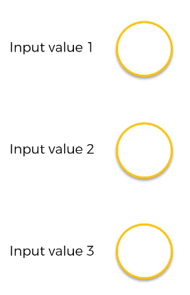
Deep Learning

Slide 23
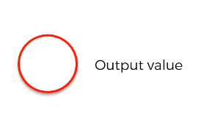
Deep Learning

Slide 24
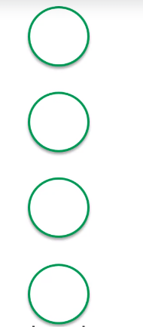
Deep Learning

Slide 25
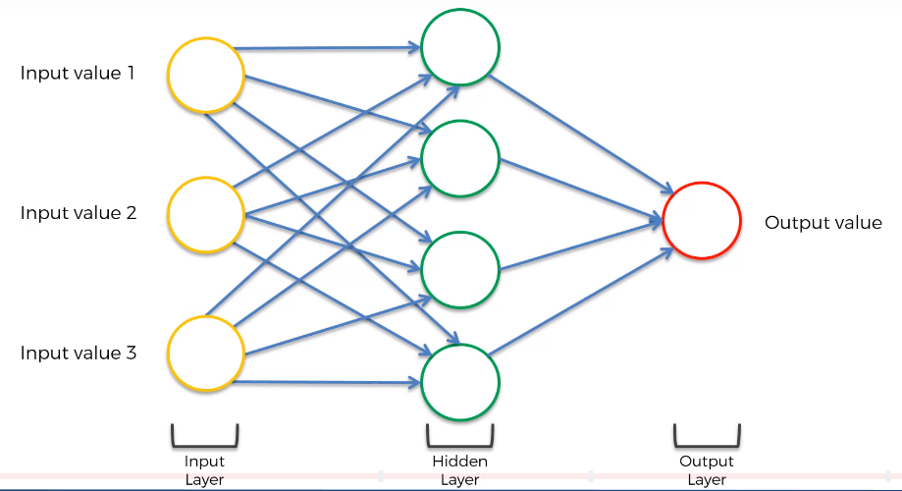
Deep Learning

Slide 26
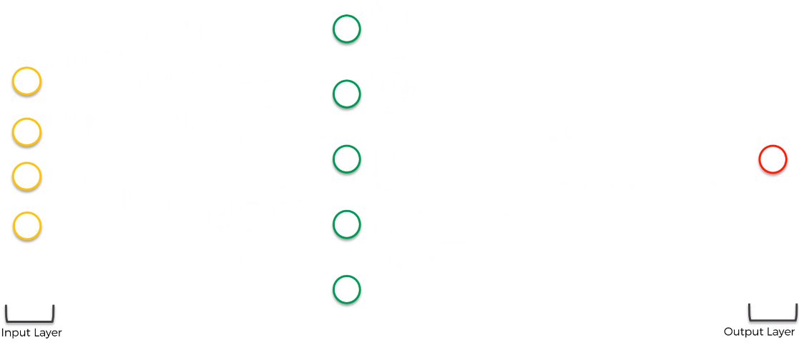
Deep Learning

Slide 27
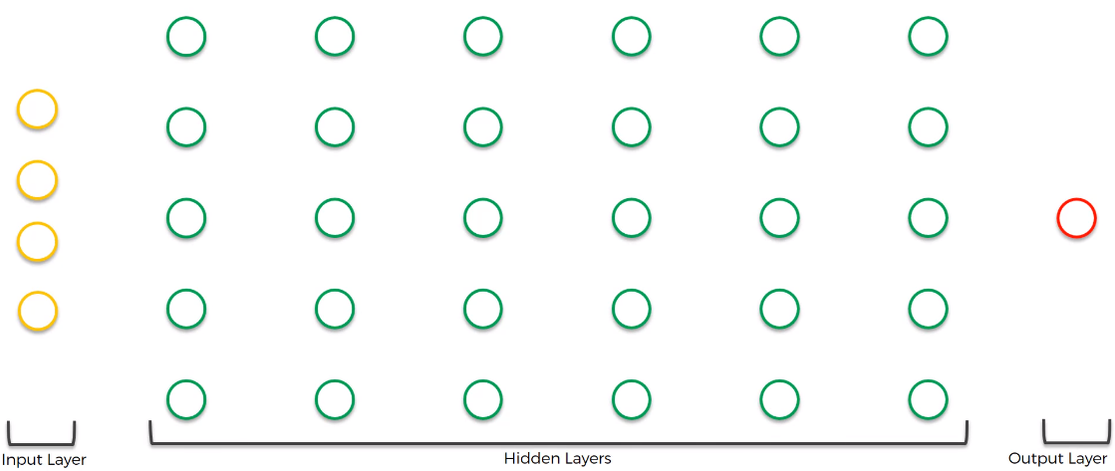
Deep Learning

Slide 28
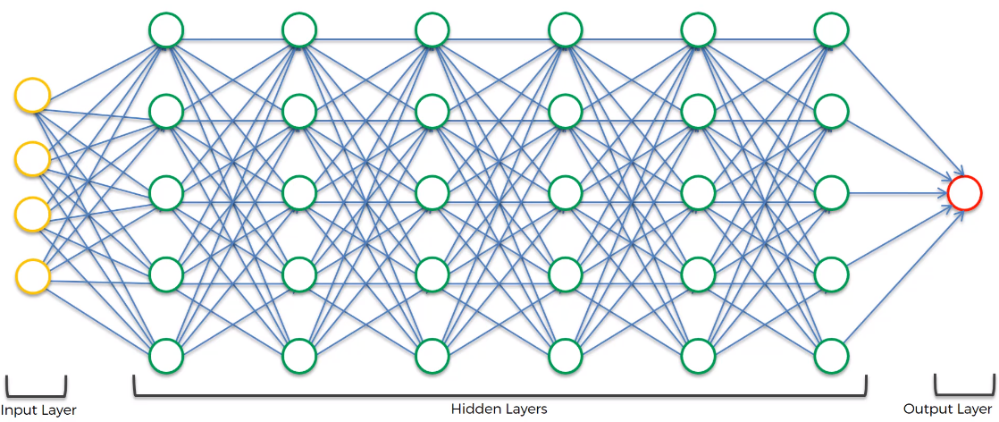
Deep Learning

